Slide 1
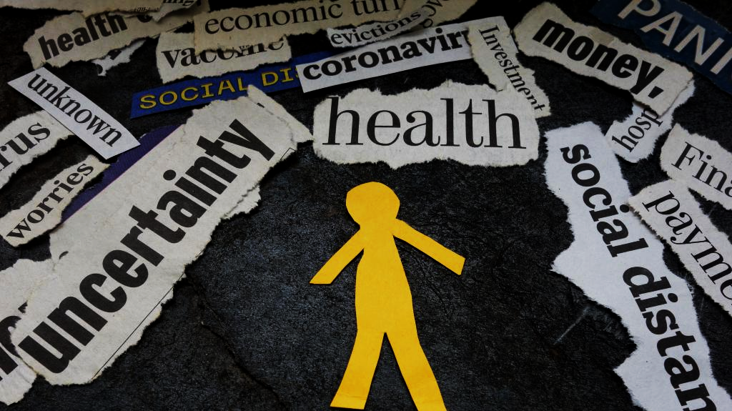
Completing the Puzzle:
Exploring the Links Between COVID-19, Isolation, Social media, and Mental Health
Group 5: Mia Liu, Audrey Gao, Sathvick Tamirsa, Kaylie Yung
Guided by mentor: Soha Ahmadi

Slide 2
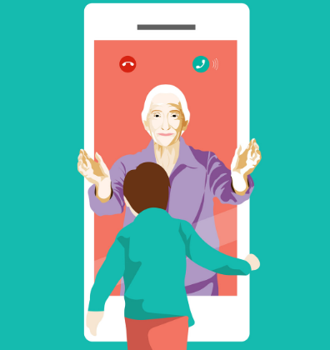
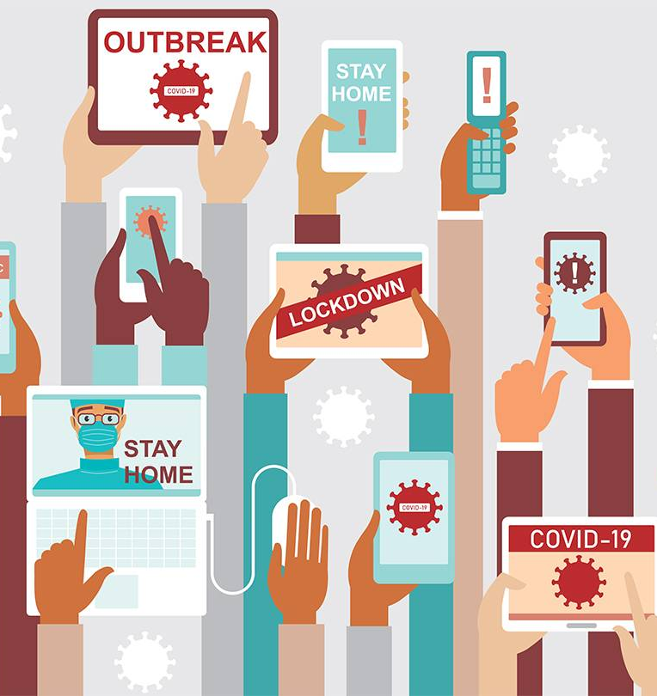
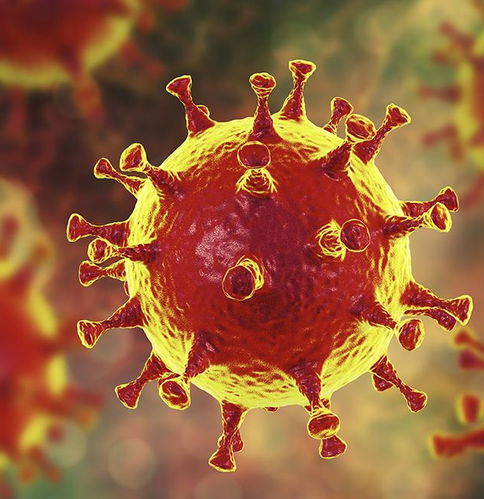
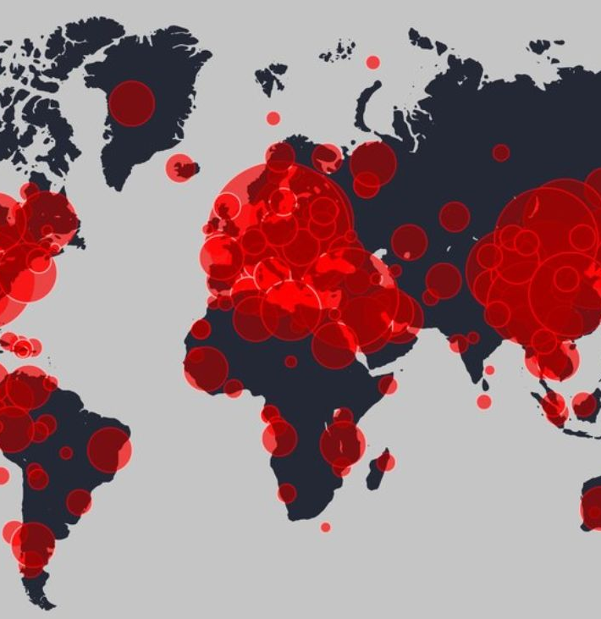
CONTEXTUALIZATION
March 11, 2020: WHO officially declared COVID as a pandemic
(World Health Organization, 2020b)
December 2019: COVID first observed in Wuhan, China
(Sauer, 2021; World Health Organization 2020a).
Quarantine measures resulted in drastic changes in lifestyle
(Vogal and Eggertson, 2020)
Fear and uncertainty led to notable rise in Technology usage, & mental health issues.
(Lin et al., 2020; Chen et al., 2021)

Slide 3
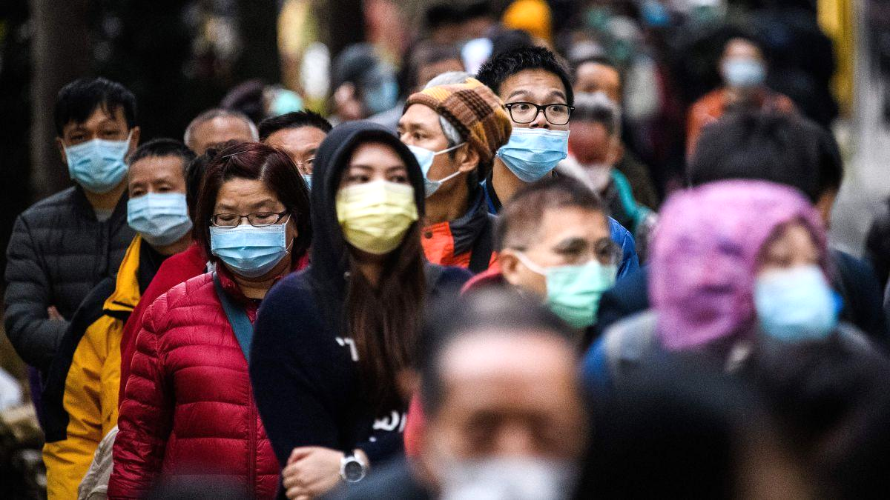
OUTLINE
What impacts does the increased use of technology during the COVID-19 Pandemic have on mental health?
How can the related research and data be interpreted based on age?
What can be done to help individuals cope with such mental health problems?
Notes:
These are the general questions that will be answered.

Slide 4
Research

Slide 5
Finding Studies
A combination of news articles and peer reviewed papers were consulted
Reputable publishers from formal databases ensure credibility
To ensure relevance, only studies focussing specifically on COVID-19 induced quarantine were referenced.

Slide 6
Methods
Criteria/Methods | Aim | Format | Sample Size | Scales Used
Chen et al., 2021 | Assesses relations between COVID-related social media usage and stress levels of school children | Two surveys November 2019 to March 2020 | Age: 8-12 550 Chinese school children | Smartphone Application-Based Addiction Scale (SABAS) Bergen Social Media Addiction Scale (BSMAS) Internet Gaming Disorder Scale-Short Form (IGDS-SF9) Depression, Anxiety Stress Scale-21 (DASS-21)
Hawke et al., 2021 | Analyzes youths’ preferences of and barriers to access of mental health services | Single survey August 2020 | Age: 14-19 | GAIN-Short Screener (GAIN-SS)
Lin et al., 2020 | Explores link between COVID- related problematic usage of social media and psychological stress | 2 surveys & a final report two weeks after Published September 2020 | 1078 Iranians Age:18+ | Hospital Anxiety and Depression Scale (HADS), Insomnia Severity Index (ISI) Bergen Social Media Addiction Scale (BSMAS) Fear of COVID-19 Scale (FCV-19S)
What we did | Aims to establish cohesive links between COVID, isolation, social media use, stress, fear, and mental health. | Closely considers 3 research articles (above) to conclude the causes and implications of COVID-related mental health issues. | Youths & young adults | Consults above scales + COVID-19 stressor
Notes:
Good!

Slide 7
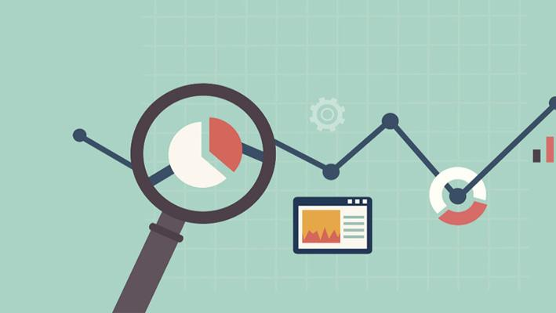
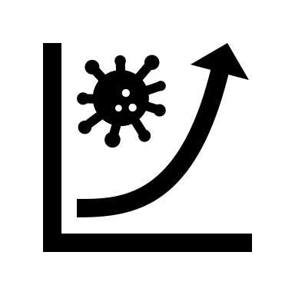
Results
Mean time spent on smartphones & the mean psychological distress level both increased.
(Chen et al., 2021)
There exists a positive relationship between fear and social-media related misunderstanding of the pandemic.
(Lin et al., 2020)
The majority of youth would consider virtual services since video calls created the optimal sharing environment.
(Hawke et al., 2021)
Despite this interest in online services, some youth have not participated due to barriers to access.
(Hawke et al., 2021)
Notes:
Chen et al. (2021) found that the mean time spent on smartphones increased significantly between Time 1 and Time 2.
The schoolchildren had higher levels of problematic smartphone-application use at Time 2.
The mean psychological distress level also increased greatly.
Lin et al. (2020) found that there exists a positive relationship between fear and social-media related misunderstanding of the pandemic.
Hawke et al. (2021) found that the majority of youth would consider virtual services.
Video calls created the optimal sharing environment.
Despite this interest and notable advantages in online services, some youth have not participated

Slide 8
Results Cont.
Figure 1: Interactions between Social Media Use, COVID-19 stressor, and Depression with 95% confidence intervals. (Zhao and Zhou, 2020)
Shows relationship between depression & social media use via the COVID-19 stressor
Both linear representations have a positive slope
This thereby indicates a positive relationship between social media use and depression.
The two lines are 1 standard deviation above and below the mean.
Notes:
The stressor data comes from a 10-point survey concerning what activities participants have been involved in during the COVID-19 pandemic. The two lines represent data 1 standard deviation above and below the mean.

Slide 9
Discussion
Limits in sampling existed, but results of the studies are well structured and consistent, confirmed by other studies
Increased time on social media but decreased gaming
Positive correlation between COVID-related increase in technology use, & mental health issues (Chen et al., 2021 ; Lin et al., 2020).
Notes:
Limits in sampling existed, however the results of the studies are well structured and consistent
Two studies showed a strong positive correlation between time spent in quarantine, technology use, and mental health issues (Chen et al. 2021, Lin et al. 2021).
In China, a study found a decrease in problematic social media use and gaming, despite increased technology use (Chen et al. 2021).
Decrease potentially explained by parents allowing children to use social media and game more during the online learning period. Thus, while the time itself was not inherently problematic
Possibility of schoolchildren being dishonest in their self-reporting (Chen et al. 2021).
Chen et al. (2021) and Lin et al. (2020) showed a strong positive correlation between time spent in quarantine, technology use, and mental health issues.
Chen et al. (2021) found that while schoolchildren in Mainland China increased their time on smartphones and social media, there was a decrease in problematic social media use and gaming.
Limits in sampling existed, however the results of the studies are well structured and consistent, confirmed by other studies
Schoolchildren in Mainland China increased their time on social media, there was a decrease in problematic social media use and gaming
May be due to dishonesty in self-reporting
Or stricter parental controls
Strong positive correlation between time spent in quarantine, technology use, and mental health issues (Chen et al., 2021 ; Lin et al., 2020).

Slide 10
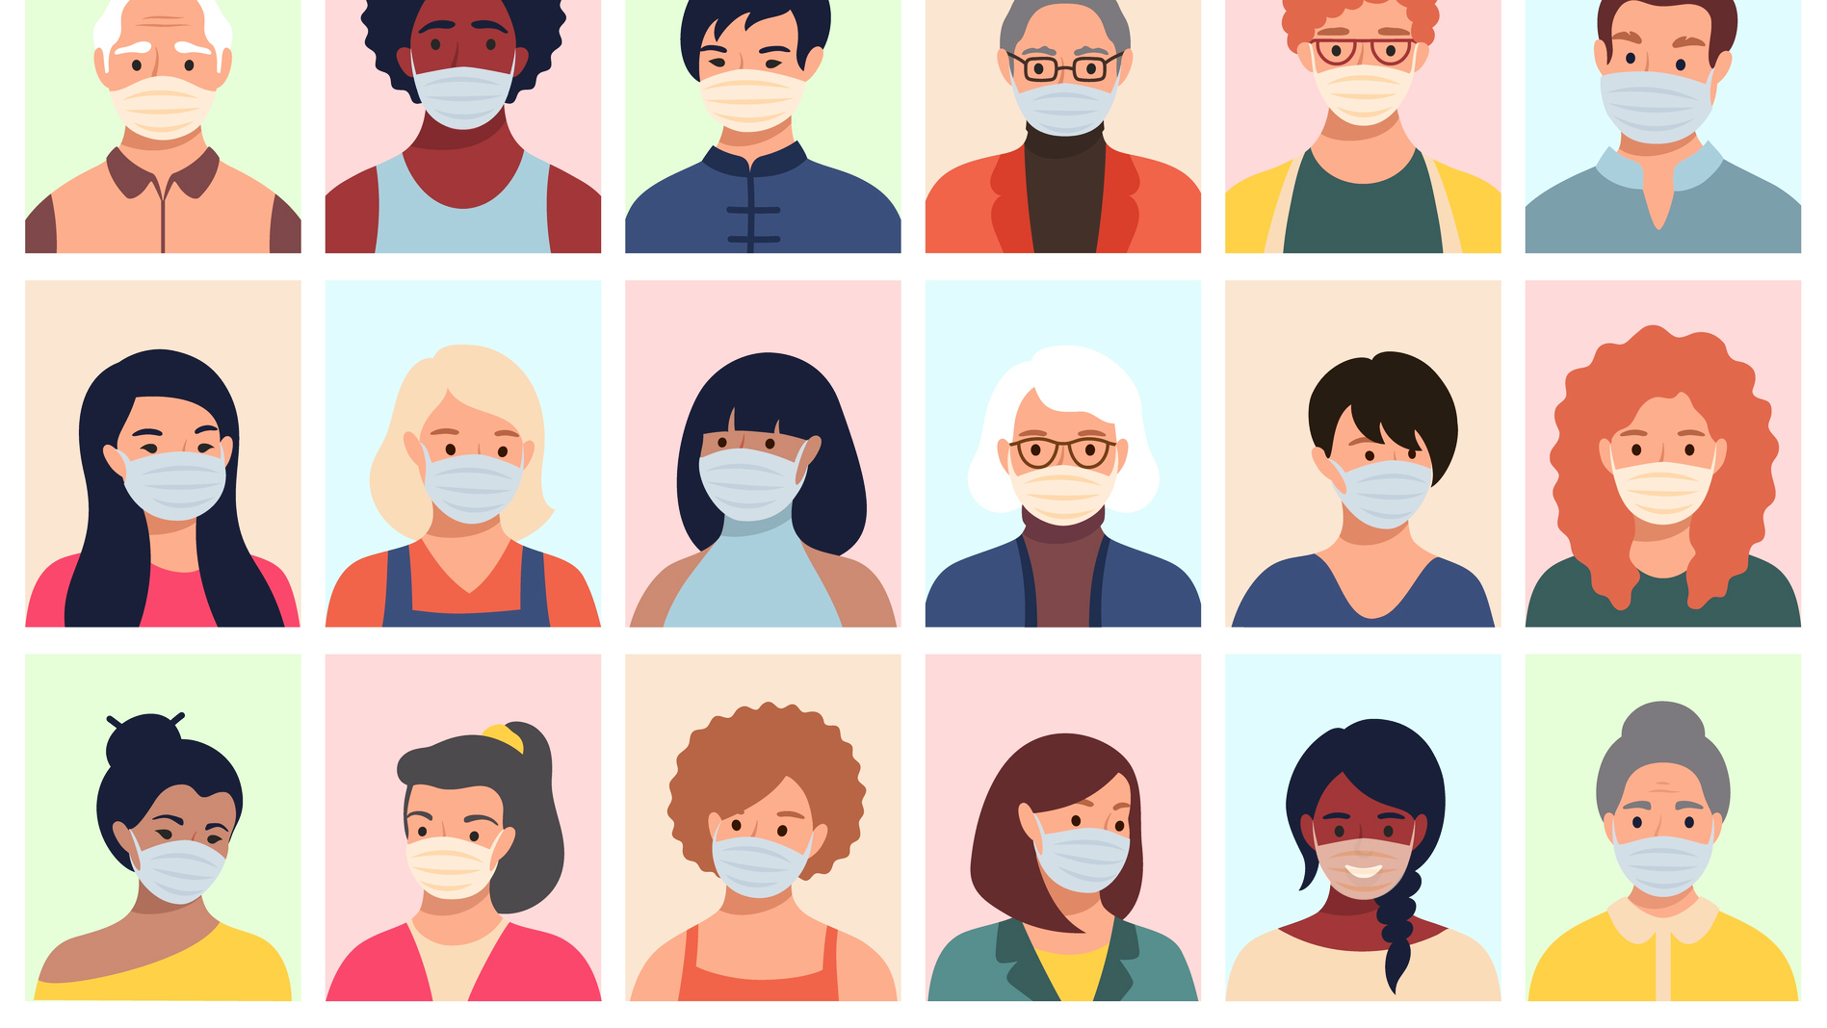
Virtual mental health services should be provided free of cost
Screen time should be monitored
Fact checking should be an ongoing process
Conclusion
Viable solutions include the enforcement of measures which curate safe virtual and in-person environments.

Slide 11
Poster View
https://www.canva.com/design/DAEoWiKmpUI/7Gf_DsBgFXVPGQy4Rahn7g/edit#

Slide 12
References
Chen, I., Chen, C., Pakpour, A. H., Griffiths, M. D., Lin, C., Li, X., & Tsang, H. W. H. (2021).
Problematic internet-related behaviors mediate the associations between levels of
internet engagement and distress among schoolchildren during COVID-19 lockdown: A longitudinal structural equation modeling study, Journal of Behavioral Addictions JBA, 10(1), 135-148. Retrieved Jul 17, 2021, from https://akjournals.com/view/journals/2006/10/1/article-p135.xml
F. Aksut Bootleg Alcohol Kills 194 People in Iran Anadolu Agency (2020) (March 22,
2020.
https://www.aa.com.tr/en/middle-east/bootleg-alcohol-kills-194-people-in-iran/1774565
Hawke, L. D., Mehra, K., Settipani, C., Relihan, J., Darnay, K., Chaim, G., & Henderson, J.
(2019, April 27). What makes mental health and substance use services youth friendly? A scoping review of literature. BMC Health Services Research. https://bmchealthservres.biomedcentral.com/articles/10.1186/s12913-019-4066-5#Sec45.
Hawke, L. D., Sheikhan, N. Y., MacCon, K., & Henderson, J. (2021, April 14). Going virtual:
youth attitudes toward and experiences of virtual mental health and substance use services during the COVID-19 pandemic. BMC health services research. https://www.ncbi.nlm.nih.gov/pmc/articles/PMC8045568/.
Lin, C. Y., Broström, A., Griffiths, M. D., & Pakpour, A. H. (2020). Investigating mediated
effects of fear of COVID-19 and COVID-19 misunderstanding in the association
between problematic social media use, psychological distress, and insomnia. Internet
Interventions, 21. https://doi.org/10.1016/j.invent.2020.100345
Ren, S., Gao, R., & Chen, Y. (2020, February 26). Fear can be more harmful than the
severe acute respiratory syndrome coronavirus 2 in controlling the coronavirus
disease 2019 epidemic. https://www.wjgnet.com/2307-8960/full/v8/i4/652.htm

Slide 13
References Cont.
Sauer, Lauren M. (2021, May 19). What Is Coronavirus?
https://www.hopkinsmedicine.org/health/conditions-and-diseases/coronavirus
U.S. National Library of Medicine. (n.d.). National Center for Biotechnology Information.
National Center for Biotechnology Information. https://www.ncbi.nlm.nih.gov/.
Vogel, LAauren., Eggerston, Laura. (n.d.). COVID-19: A timeline of Canada's first-wave
response. CMAJ News. https://cmajnews.com/2020/06/12/coronavirus-1095847/.
World Health Organization. (2020, March 11). WHO Director-General's opening remarks at
the media briefing on COVID-19 - 11 March 2020.
https://www.who.int/director-general/speeches/detail/who-director-general-s-opening-remarks-at-the-media-briefing-on-covid-19---11-march-2020
World Health Organization. (2020, June 29). Listings of WHO’s response to COVID-19.
https://www.who.int/news/item/29-06-2020-covidtimeline
Zhao, N., & Zhou, G. (2020, September 17). Social media use and mental health during THE
COVID‐19 pandemic:
Moderator role of disaster stressor and MEDIATOR role of negative affect. International Association of Applied Psychology
https://iaap-journals.onlinelibrary.wiley.com/doi/full/10.1111/aphw.12226

Slide 14
End
Thank you!

